Slide 1
Ana Ramazashvili
ანა რამაზაშვილი
GEORGIA, TBILISI

Slide 2
G e o r g i a

Slide 3
Georgia – Sakhartvelo

Slide 4
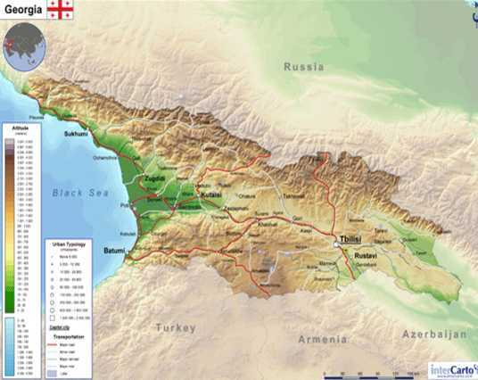
Basic information:
County Area - 69,700 km²
Population – 3,5 million
Language – Georgian

Slide 5
Georgian Alphabet

Slide 6
T b i l i s i

Slide 7
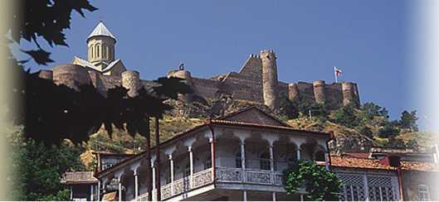
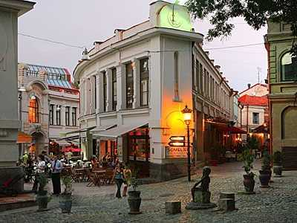
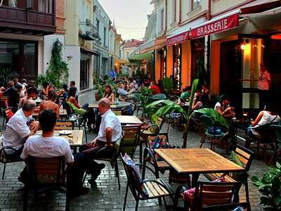
Old Tbilisi

Slide 8
King Vaxtang Gorgasali – The Builder

Slide 9
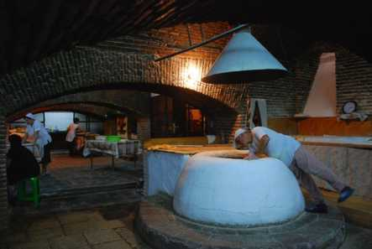
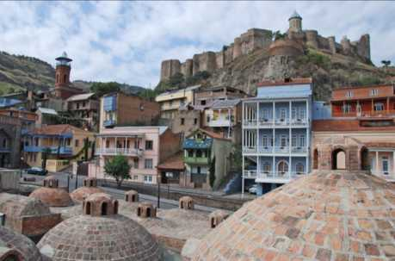

Slide 10
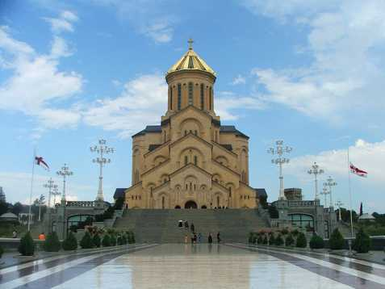
All Nationalities are free to their religion choice

Slide 11
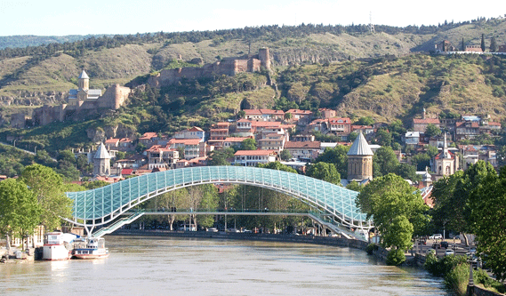
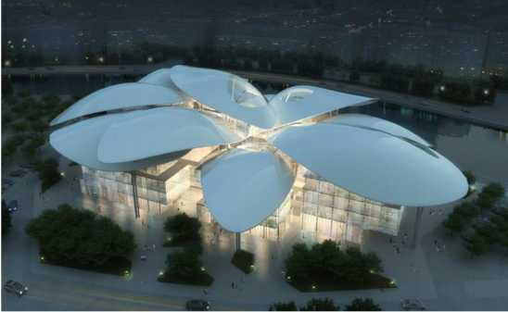
New architecture buildings

Slide 12
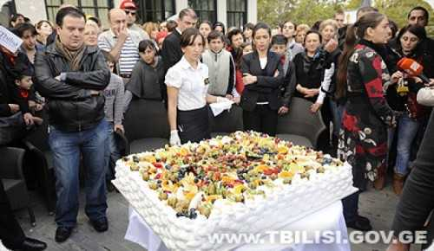
T b i l i s o b a

Slide 13
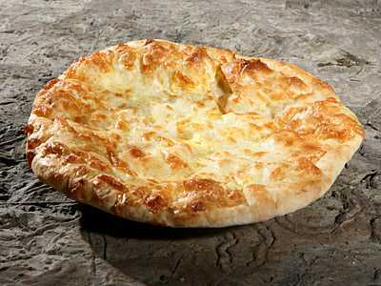
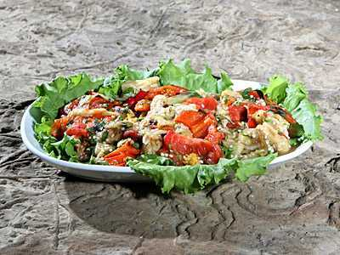
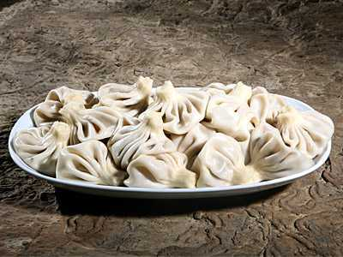
Georgian Food

Slide 14
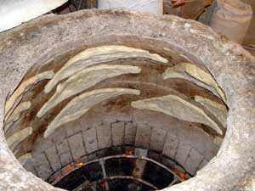
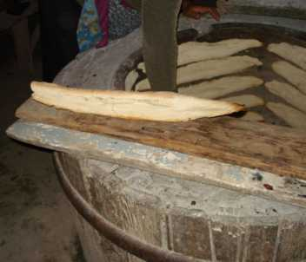
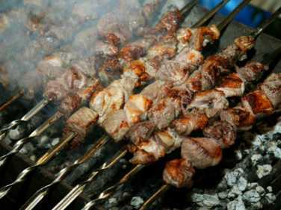
Mtsvadi & Shoti

Slide 15
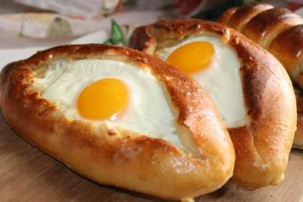
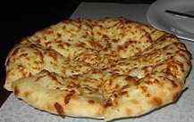
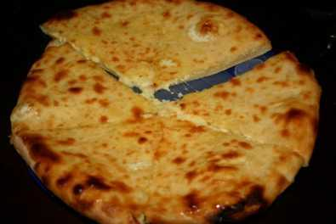
Khachapuri

Slide 16
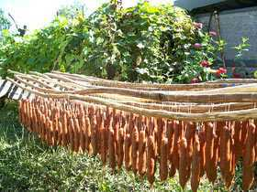
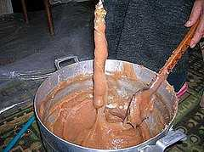
Most delicious
CHURCHXELA

Slide 17
Gozinaki is a traditional Georgian confection made of caramelized nuts, usually walnuts, fried in honey, and served exclusively on New Year’s Eve and Christmas.

Slide 18
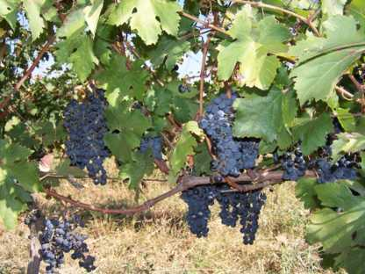
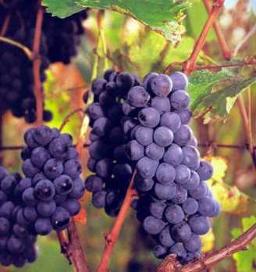
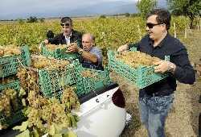
Autumn

Slide 19
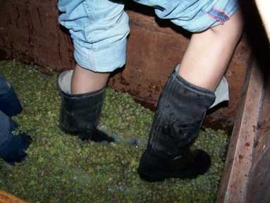
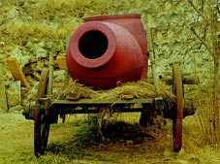
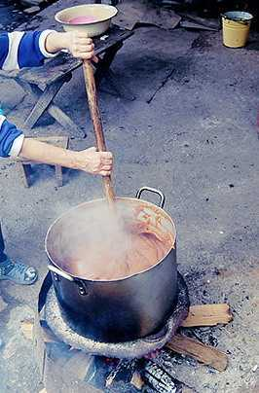
Autumn

Slide 20
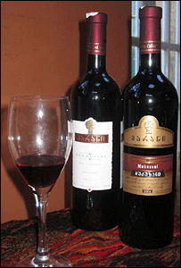
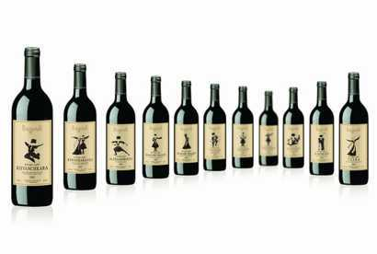
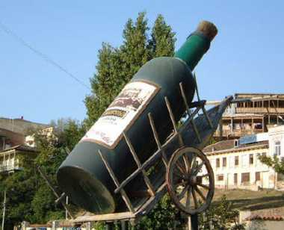
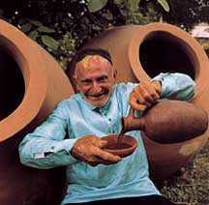
Country of wine

Slide 21
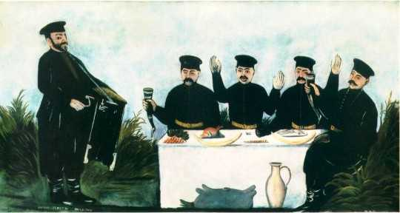
Sufra & Tamada

Slide 22
Every Part Of Georgia has it’s own local specifics

Slide 23
How does their traditional clothes look because of their living conditions

Slide 24
Georgian traditional dress

Slide 25
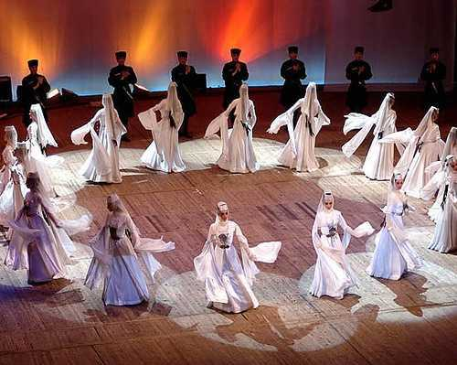
“ All the ills of mankind, All the tragic misfortunes that fill the history books, All the political blunders, All the failures of the great leaders have arisen merely from a lack of skill at dancing"

Slide 26
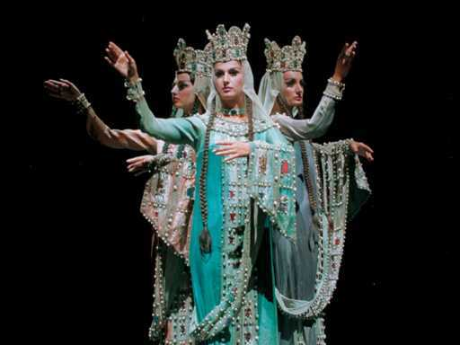
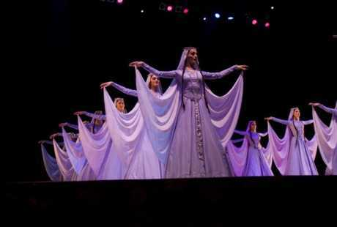
Georgian Folk Dance
Samaia
Svanuri
Narnari
Acharuli
Mtiuluri
Qartuli

Slide 27
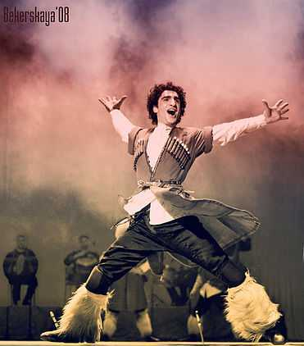
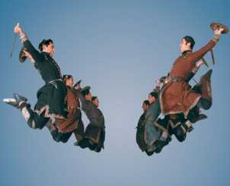
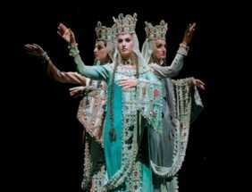
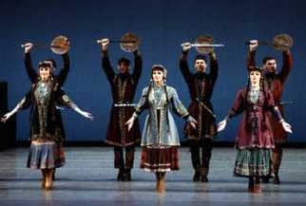
"Dancing is the loftiest, most moving, the most beautiful of the arts, because it is no mere translation or abstraction from life:
IT IS LIFE ITSELF!"
Notes:
M

Slide 28
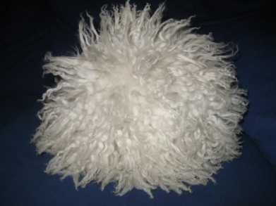
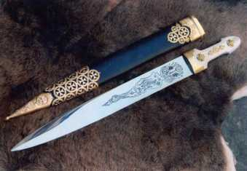
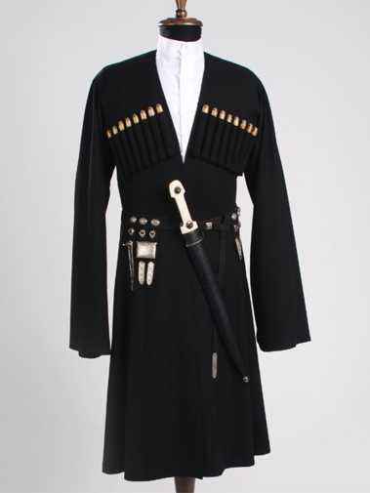
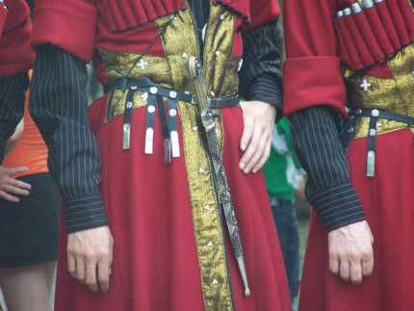
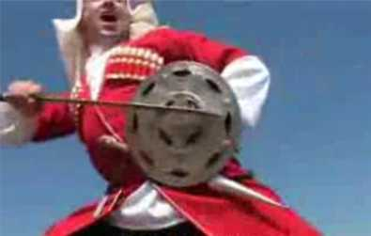
Fafaxi
Choxa-axaluxi
Khanjali
Dancer Boys Equipment
Fari

Slide 29
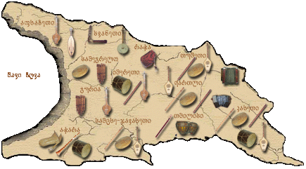
Georgian Folk InstrumentsGeorgian Folk Instruments

Slide 30
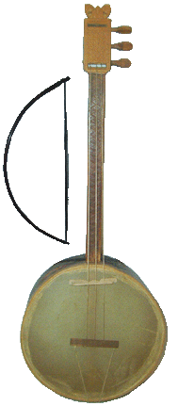
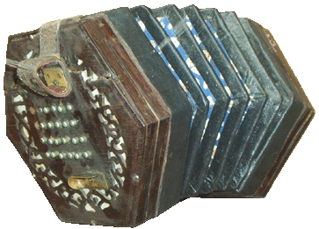
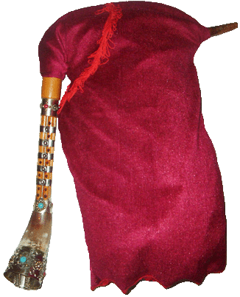
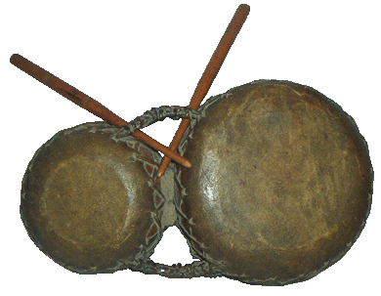
Salamuri
Tsiko-tsiko
Chuniri
Gudastviri
Diplipito

Slide 31
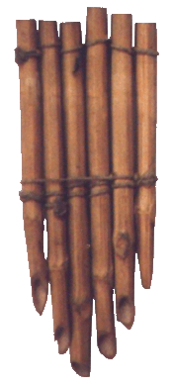
Daira
Soinari
Buki
Fanduri
Changi

Slide 32
Georgian song “Chakrulo” was sent into cosmos by NASA in 1977

Slide 33
Svaneti - სვანეთი

Slide 34
Tusheti - თუშეთი

Slide 35
National Parks
Tusheti National Park
Borjomi-Kharagauli National Park

Slide 36
Golden Georgia Resorts
“ A great sense of freedom and well-being permeated me. All my tiredness had gone and I felt strong
enough to lift a mountain”

Slide 37
Winter resorts
Bakuriani
Gudauri

Slide 38
Batumi

Slide 39
Signagi / Love city

Slide 40
Gamarjoba – Hello Nakhvamdis – Good bye Madloba – Thank you Me var … - I am … Me var Polonetidan – I am from Poland

Slide 41
Dziękuję ! მადლობა ! (Madloba) Thank you !

